Slide 1
Feature Fusion based detection of Schizophrenia using fMRI dataset
Team No: ECE063
Project Mentor: Suguna G
Team Members:
Mohan V | CB.EN.U4CCE20033
Nithin Rajaseharan | CB.EN.U4CCE20039
Taushiq Balamurugan | CB.EN.U4CCE20064
Varun S | CB.EN.U4CCE20069

Slide 2
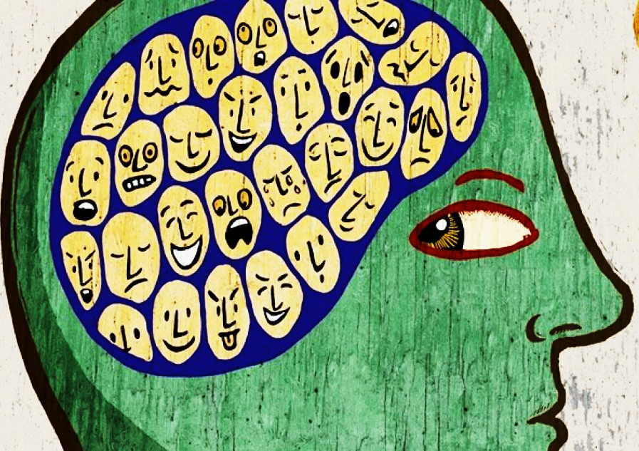
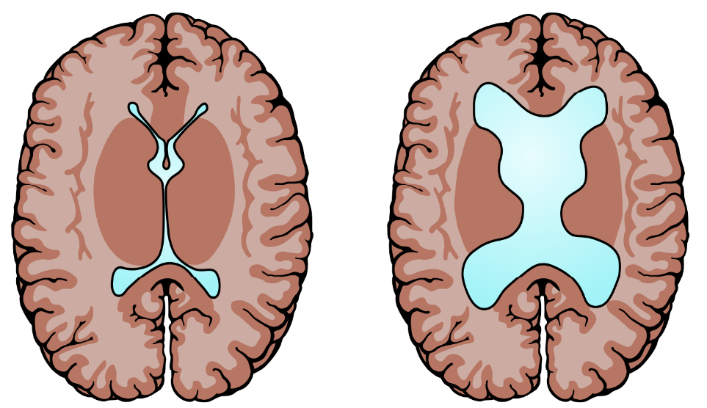
Introduction
Schizophrenia - Abnormal interpretation
of reality.
Symptoms : hallucinations, delusions, disorganized thinking, and emotional disturbances.
According to WHO, 20 million people worldwide have schizophrenia.
Brain abnormalities:
Reduced gray matter volume
Enlarged ventricles
White matter abnormalities

Slide 3
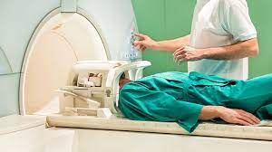
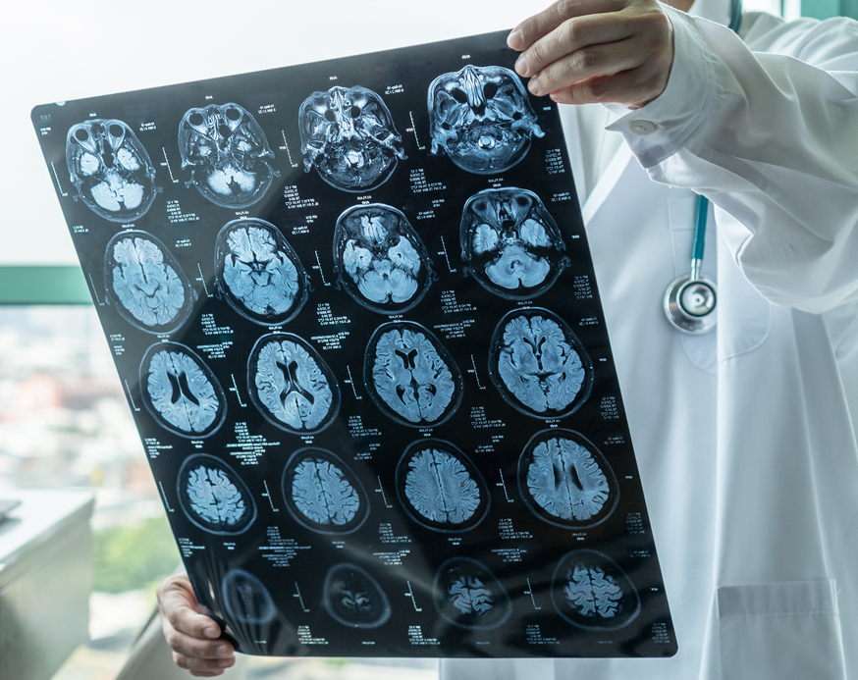
Problem statement
Subjective evaluation by psychiatrist.
Time-consuming process for the psychiatrist to manually check the MRI scans
Detection gets delayed through manual evaluation.
Misdiagnosis due to lack of Computer Aided Diagnosis(CAD) system for evaluation.

Slide 4
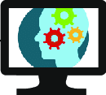
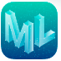
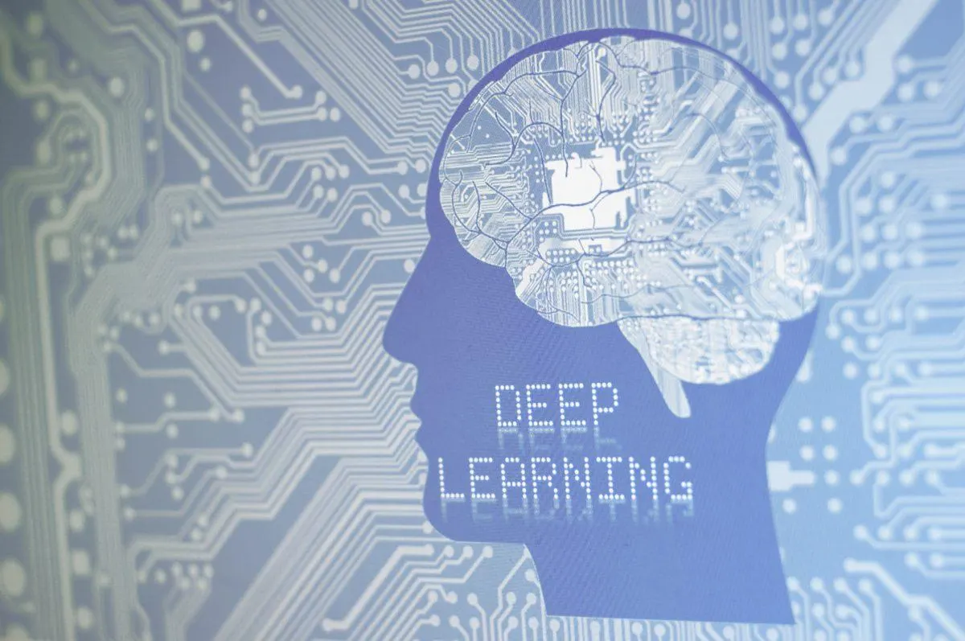
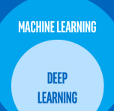
Objectives
Computer-Aided Diagnosis (CAD) system for schizophrenia
detection using fMRI dataset
Implementation of CAD system using Hand-crafted features
Implementation of CAD system using Deep features
Integration of ML features and Deep features to create a standard
CAD system for the diagnosis of schizophrenia

Slide 5
Literature Survey
S.No | Paper Title | Publication | Year
1 | Framework to Detect Schizophrenia in Brain MRI Slices with Mayfly Algorithm-Selected Deep and Handcrafted Features | Journal of Sensors, vol. 23, no. 1, pp. 280, Multidisciplinary Digital Publishing Institute(MDPI) | 2022
2 | Diagnosis of schizophrenia based on deep learning using fMRI | Computational and Mathematical Methods in Medicine, Hindawi Limited | 2021
3 | Detecting abnormal brain regions in schizophrenia using structural MRI via machine learning | Computational intelligence and neuroscience, Hindawi Limited | 2020
4 | Fusion of handcrafted and deep features for medical image classification | Journal of Physics: Conference Series, vol. 1345. No. 2. Institute of Physics Publishing Publishing | 2019
5 | Machine learning techniques in a structural and functional MRI diagnostic approach in schizophrenia: a systematic review | Neuropsychiatric Disease Treatment : 1605-1627, Dove Medical Press Ltd | 2019

Slide 6
Literature Survey
S.No. | Paper Title | Publication | Year | Inference
6 | Improved Multiclassification of Schizophrenia Based on Xgboost and Information Fusion for Small Datasets | Computational and Mathematical Methods in Medicine, Hindawi Limited | 2022 | fMRI dataset Sensitivity - 73.89% Performance of fusion classifier is better than others.
7 | Identifying schizophrenia using structural MRI with a deep learning algorithm | Frontiers in psychiatry | 2020 | sMRI dataset AUC of 0.71 to 0.90 Brain region contributing the most is right temporal area
8 | Detecting schizophrenia with 3d structural brain mri using deep learning | Scientific Reports, Nature Research | 2023 | sMRI dataset 3D CNN architecture Brain region contributing the most is subcortical brain structure.
9 | Structural neuroimaging as clinical predictor: A review of machine learning applications | Elsevier Inc. | 2018 | For diagnosis, fMRI and sMRI are used. SVM and Random Forests reported 61.8–95% accuracy
10 | Towards artificial intelligence in mental health: a comprehensive survey on the detection of schizophrenia | Springer | 2023 | CAD systems assist radiologists and doctors in the early diagnosis Deep learning is the most effective method.

Slide 7
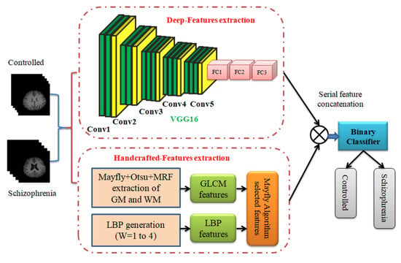
Literature Survey – BASE PAper
Title: Framework to Detect Schizophrenia in Brain MRI Slices with Mayfly Algorithm-
Selected Deep and Handcrafted Features
Publication: Journal of Sensors, Multidisciplinary Digital Publishing Institute (2022)
Inference:
fMRI dataset - 20 schizophrenia and
20 controlled class
Accuracy:
DF – 90%
HF – 85%
DF + HF – 95%
DF+HF is better compared with other methods

Slide 8
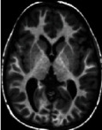
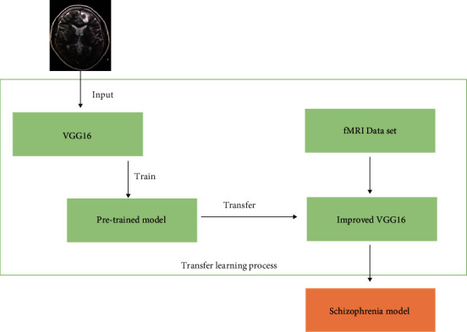
Literature Survey – Reference PAper
Title: Diagnosis of schizophrenia based on deep learning using fMRI
Publication: Computational and Mathematical Methods in Medicine, Hindawi Limited (2021)
Inference:
Preprocessed fMRI data
Perform correlation analysis on regions of interest, using transfer learning and VGG16 net.
Accuracy – 87.85%
Improve the early diagnosis of schizophrenia
Solve the classification problem of small samples and high-dimensional data

Slide 9
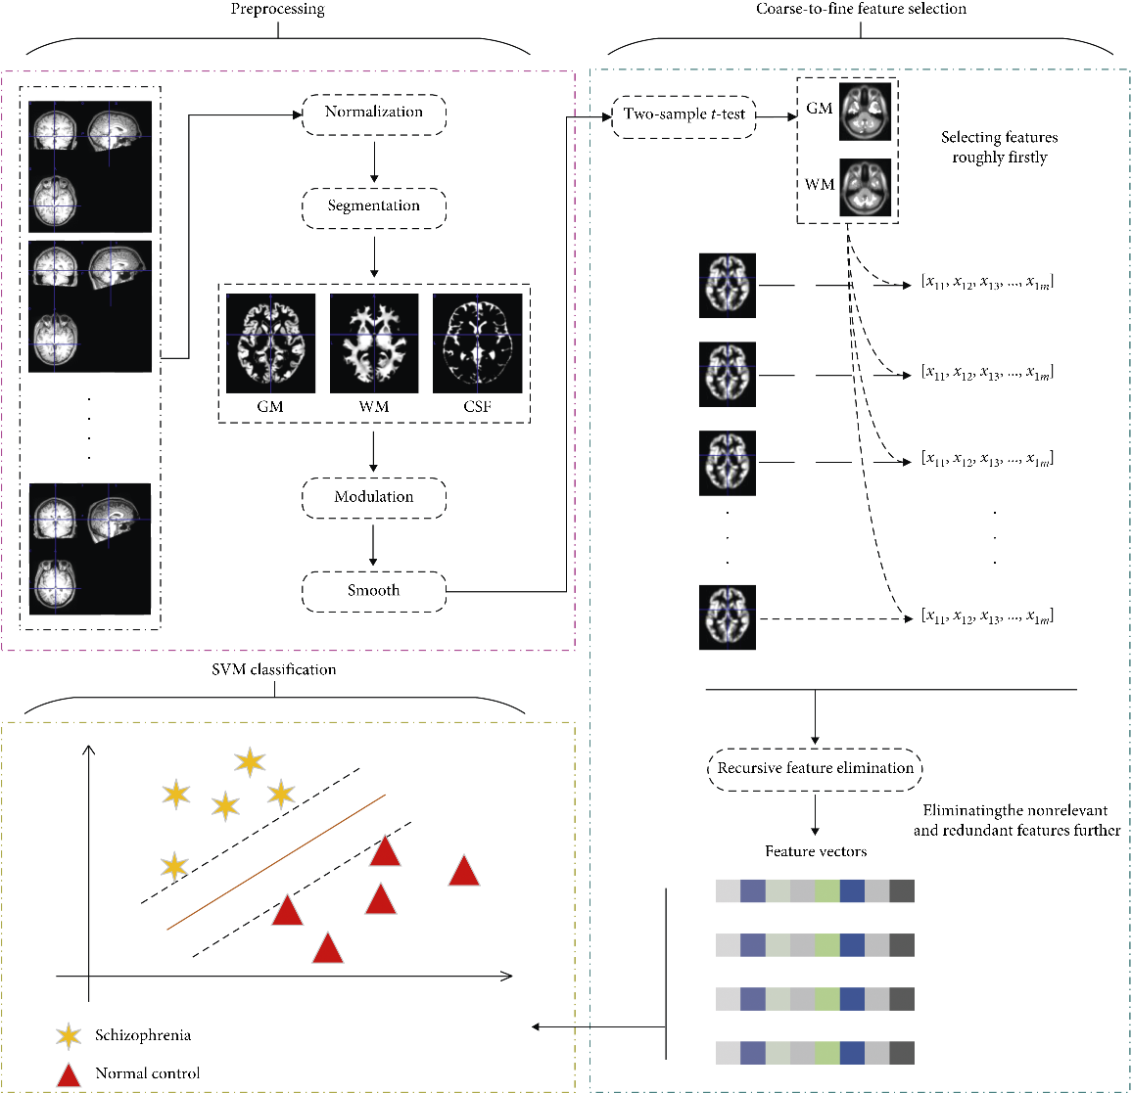
Literature Survey – Reference PAPER
Title: Detecting abnormal brain regions in schizophrenia using structural
MRI via machine learning
Publication: Computational intelligence and neuroscience, Hindawi Limited, 2020
Inference:
sMRI dataset
Feature - Gray matter(GM) and White matter(WM)
Two-sample t-tests to extract the differences between groups first, then further eliminated the nonrelevant and redundant features with recursive feature elimination (RFE)
Accuracy - 85%
Classification performance of WM was significantly better than that of GM

Slide 10
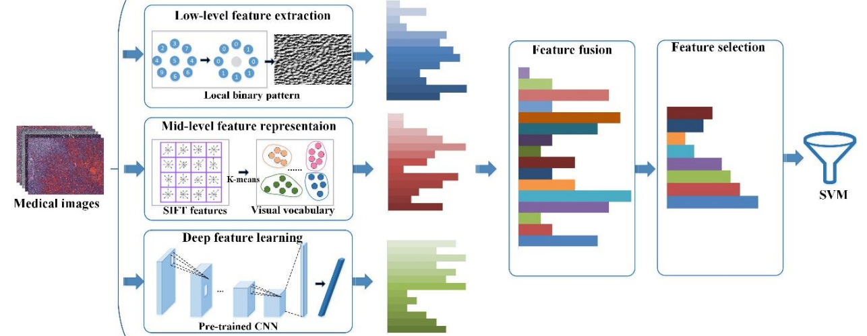
Literature Survey – Reference PAper
Title: Fusion of handcrafted and deep features for medical image classification Publication: Journal of Physics: Conference Series, vol. 1345. No. 2. Institute of Physics Publishing Publishing (2019)
Inference:
Medical image classification
Low-level feature extraction - Lose semantic information
Mid-level feature extraction - Carry semantic information to some extent
Deep feature extraction - Directly extract feature from image without any priori knowledge
To overcome the respective weakness, a handcrafted and deep feature fusion framework for medical image classification can be used

Slide 11
Literature Survey – Reference PAper
Title: Machine learning techniques in a structural and functional MRI diagnostic
approach in schizophrenia: a systematic review
Publication: Neuropsychiatric Disease Treatment : 1605-1627, Dove Medical Press Ltd (2019)
Inference:
SVM is the most used technique
Diverse inputs (GM & WM) improve the accuracy
Accuracy – 75% to 90% in classification
Integration of multiple ML techniques will be increasingly decisive in the future for the early diagnosis

Slide 12
Methodology
Deep Feature Implementation:
Binary Classifier
FMRI Dataset
(Schizophrenia, Healthy)
Convolutional Layer
Fully Connected Layer
Pre-Trained CNN model [VGG16]
Transfer Learning
Healthy
Schizophrenia

Slide 13
Methodology
Hand Crafted Feature Implementation:
GLCM and LBP
Binary Classifier
FMRI Dataset
(Schizophrenia, Healthy)
Two Sample t-tests
Axial Plane Segmentation
(GM, WM)
Recursive Feature Elimination
Healthy
Schizophrenia

Slide 14
Methodology
DF + HF feature Implementation:
Deep Feature Extraction
VGG16 (Transfer Learning)
Feature Concatenation
PCA
Feature Reduction &
Transformation
Binary Classifier
FMRI Dataset
(Schizophrenia, Healthy)
Hand Crafted Feature Extraction
GLCM and LBP
Healthy
Schizophrenia
Axial Plane Segmentation
(GM, WM)
Two Sample t-tests
Recursive Feature Elimination

Slide 15
REferences
Manic, K. S., Rajinikanth, V., Al-Bimani, A. S., Taniar, D., & Kadry, S. (2022), “Framework to Detect Schizophrenia in Brain MRI Slices with Mayfly Algorithm-Selected Deep and Handcrafted Features”, Journal of Sensors, vol. 23, no. 1, pp. 280, Multidisciplinary Digital Publishing Institute(MDPI), 2022. doi: https://doi.org/10.3390/s23010280
Zheng, JinChi, et al. , "Diagnosis of schizophrenia based on deep learning using fMRI“, Computational and Mathematical Methods in Medicine, Hindawi Limited, 2021. doi: https://doi.org/10.1155/2021/8437260
Chen, ZhiHong, et al. "Detecting abnormal brain regions in schizophrenia using structural MRI via machine learning." Computational intelligence and neuroscience, Hindawi Limited, 2020. doi: https://doi.org/10.1155/2020/6405930
Liu, Dong, et al. "Fusion of handcrafted and deep features for medical image classification." Journal of Physics: Conference Series, vol. 1345. No. 2. Institute of Physics Publishing Publishing, 2019. doi: https://doi.org/10.1002/brb3.3002
de Filippis R, Carbone EA, Gaetano R, Bruni A, Pugliese V, Segura-Garcia C, De Fazio P, “Machine learning techniques in a structural and functional MRI diagnostic approach in schizophrenia: a systematic review”, Neuropsychiatric Disease Treatment : 1605-1627, Dove Medical Press Ltd, 2019. doi: https://doi.org/10.2147/NDT.S202418

Slide 16
REferences
Zhu, Wenjing, Shoufeng Shen, and Zhijun Zhang, "Improved Multiclassification of Schizophrenia Based on Xgboost and Information Fusion for Small Datasets" , Computational and Mathematical Methods in Medicine, Hindawi Limited, 2022. doi: https://doi.org/10.1155/2022/1581958
Oh, Jihoon, Baek-Lok Oh, Kyong-Uk Lee, Jeong-Ho Chae, and Kyongsik Yun, "Identifying schizophrenia using structural MRI with a deep learning algorithm.“, Frontiers in psychiatry, 2020. doi: https://doi.org/10.3389/fpsyt.2020.00016
Zhang, Junhao, Vishwanatha M. Rao, Ye Tian, Yanting Yang, Nicolas Acosta, Zihan Wan, Pin-Yu Lee et al. "Detecting schizophrenia with 3d structural brain mri using deep learning." Scientific Reports 13, no. 1 pp. 14433, Nature Research, 2023. doi: https://doi.org/10.1038/s41598-023-41359-z
Mateos-Pérez, José María, Mahsa Dadar, María Lacalle-Aurioles, Yasser Iturria-Medina, Yashar Zeighami, and Alan C. Evans, "Structural neuroimaging as clinical predictor: A review of machine learning applications.“, NeuroImage: Clinical vol. 20 pp. 506-522, Elsevier Inc. ,2018. doi: https://doi.org/10.1155/2020/6405930
Tyagi, Ashima, Vibhav Prakash Singh, and Manoj Madhava Gore. "Towards artificial intelligence in mental health: a comprehensive survey on the detection of schizophrenia." Multimedia Tools and Applications 82, no. 13 , pp. 20343-20405., Springer, 2023. doi: https://doi.org/10.1002/brb3.3002

Slide 17
Thank You
Team ECE063

